Slide 1
Student Technology
- Resource Guide -

Slide 2
There are many different websites and resources that students use during their journey at Ridgewater College. It can be hard to keep track of each site and remember the purpose and features of each site. This quick guide will help you keep it all straight as you are starting or continuing your journey with us.

Slide 3
Many of the important sites you will use can be found on the Ridgewater homepage under the “Logins” dropdown menu.

Slide 4
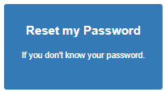
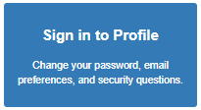
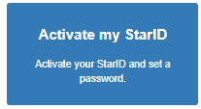
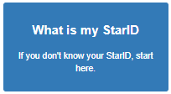
STARID
This username and password is used for ALL of your login requirements.
D2L
Email
E-Services
Wireless network
Campus computer login
On-campus printing
*If you have problems resetting your STARID password, call the Registration Office to assist you, (320) 222 - 5971.
*Video tutorial available on D2L (see next slide).

Slide 5
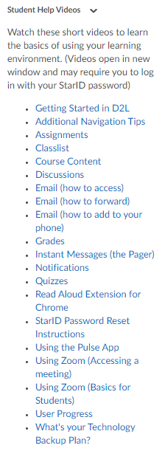
D2L
Use to access material pertinent to your courses such as syllabi and lecture notes. D2L may also be utilized by your instructor for homework, assignment submissions, class discussions, and quizzes. Pro Tip: You can customize settings to send notifications to your email, phone, or app.
*Student Help Videos are located on the bottom right side of the D2L homepage that are helpful to not only learn how to navigate D2L, but also cover other tech resources.
Recommended Tutorials - Getting Started in D2L - Additional Navigation Tips
- Email
- Using Zoom
- StarID Password Reset Instructions

Slide 6
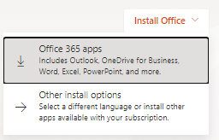
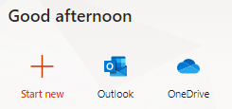
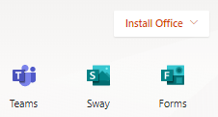
Email
Use to contact Ridgewater faculty and staff, use for professional purposes, and receive communication from faculty and Ridgewater College.
To access your email, go to Office365. To login, use “STARID@go.minnstate.edu” for the user and your STARID password. Your Ridgewater email is typically firstname.lastname@Go.Ridgewater.edu.
Your email account will also give you access to Microsoft Office products such as Word, PowerPoint, and Excel. - Online versions available to all devices. - Download available to Windows and Mac devices.
*Video tutorials available on D2L.

Slide 7
Zoom
Instructors may use this videoconferencing software for class lectures or office hours, but Zoom can also be used to work on group projects, study groups, and more.
Go to: https://minnstate.zoom.us and sign in with your STARID. Once logged in, go to: Resources > Download Zoom Client and download to your computer or laptop for use.
Mobile devices may download the Zoom Cloud Meetings app. When signing in, select SSO, type in “minnstate”, and press “Go” which will direct you to sign in with your STARID for mobile use.
*Video tutorials available on D2L.

